Slide 1
STEWARDSHIP OF TIME Eph 5:15, 16
FACILITATED BY:
PASTOR LAU AGBARA

Slide 2
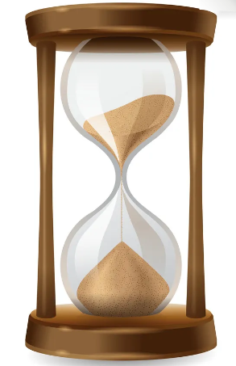
Concept of Time
God packaged life in Time
Time is a finite resource
God is in control of Time [Dan 12:21]

Slide 3
How we use Time (weekly)
ACTIVITY | HOURS
Rest, Eat, Recreate & Hygiene | 55
Worship, Pray & Fellowship | 10
Work / Class Work | 45
Commuting / Waiting | 10
Cook/Phone Calls/News | 8
Sub-Total | 128
Balance (24%) | 40
Mind the 80/20 Rule (Pareto Principle)

Slide 4
POWER OF FREE TIME
“Our success will be in direct proportion to how you spend your ‘free’ time.”
Mike Dunlap (Head coach)

Slide 5
Mastery of Time
Purpose
To everything there is a season
Priority
A time to kill and a time to heal …
Persevere
Consistent wise use of time brings profit

Slide 6
Habit 1: Invest Time in Quality Activities
Relationships that matter
Self Development
Thinking & Planning
The RST activities accelerate destiny
Mind the 80/20 Rule (Pareto Principle)

Slide 7
Habit 2: Plan your Time
DO
FIRST
DO
Next
Importance
Delegate/
Do Later
Delete
Urgency

Slide 8
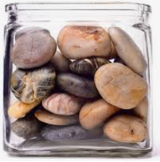
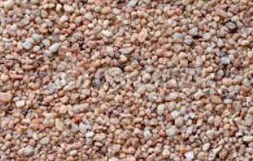
Priority Matrix - Examples
Seeking God
Family
Health
Career
Do First :
Planning
Self Development
Vacation
Social Connect
Do Next :
Don’t be addicted to ‘Just-in-Time’

Slide 9
Habit 3: Persevere
‘Don't put off until tomorrow what you can do today’ - Benjamin Franklin
Consider this example from the bible
5 Foolish Virgins
Matt 25:1 - 13
Understanding of the Times will make you Outstanding

Slide 10
Thank You

